Slide 1
Inventory management system

Slide 2
Introduction
Nathan
A level
Worked at vodafone

Slide 3
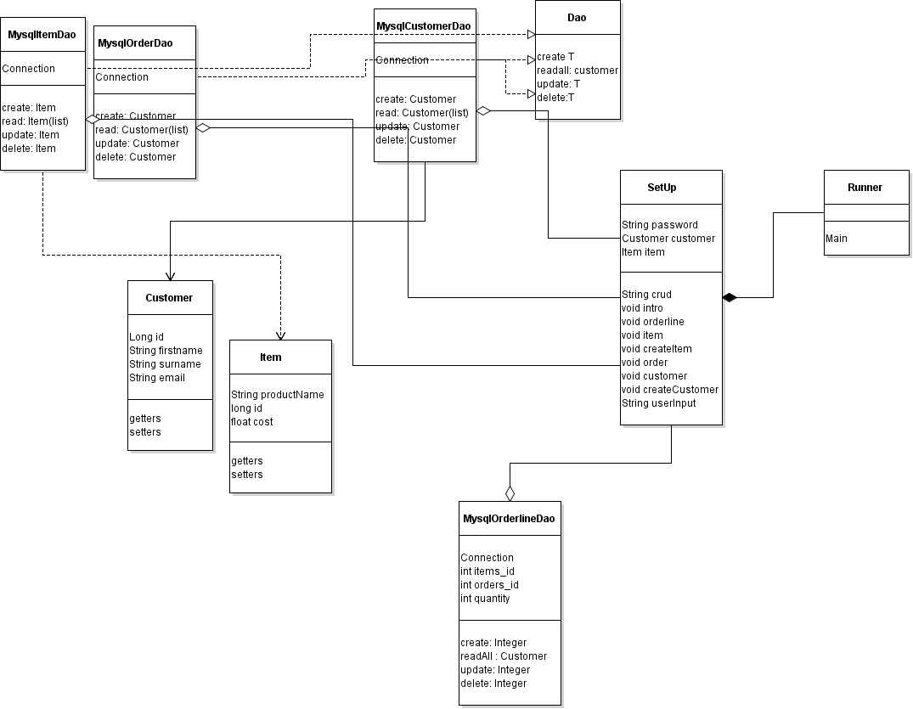
Design

Slide 4
Design
S - Single-responsiblity principle.
O - Open-closed principle.
L - Liskov substitution principle.
I - Interface segregation principle.
D - Dependency Inversion Principle.

Slide 5
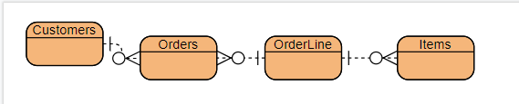
Entity relationship diagram

Slide 6
OPS
Using jenkins for CI
Using sonarqube for static analysis
Using nexus for artifacts

Slide 7
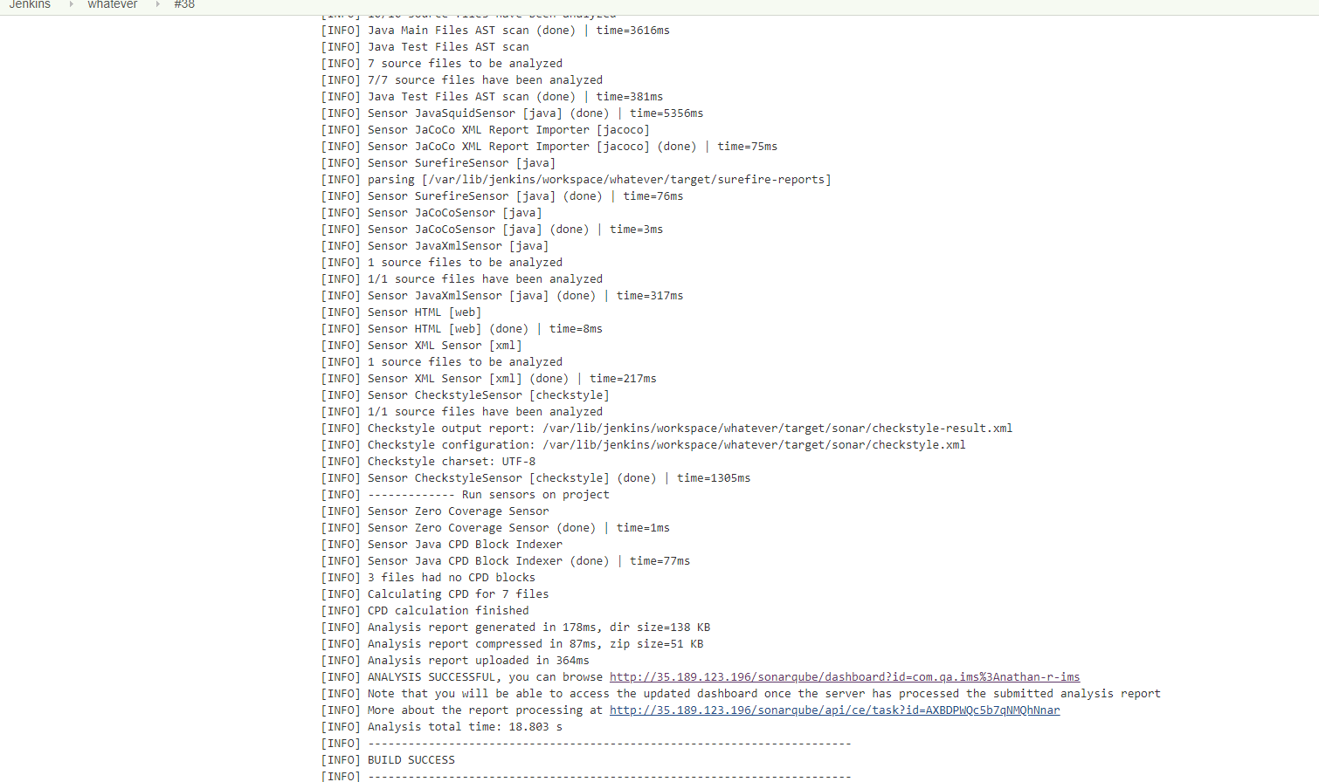
Jenkins build

Slide 8
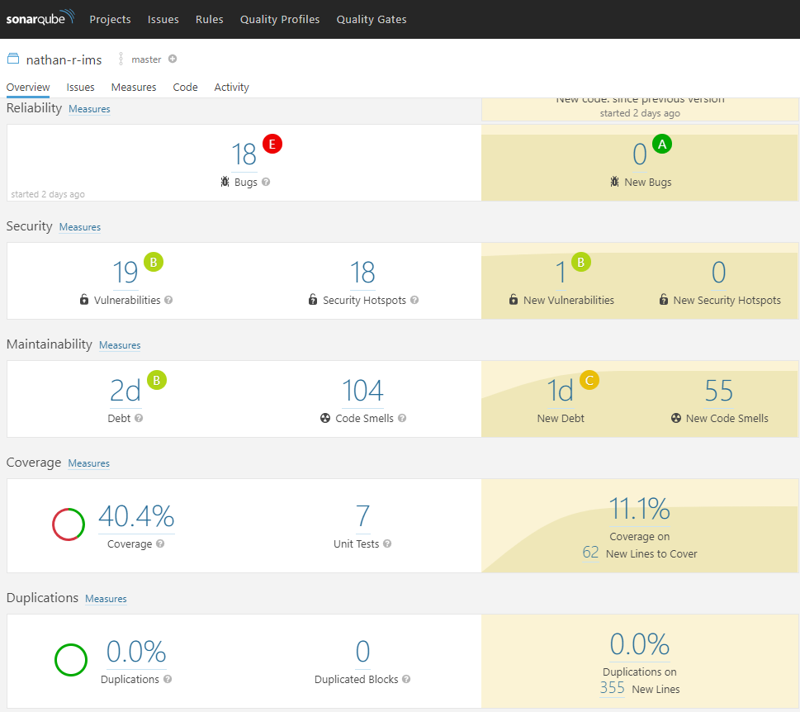
Sonarqube
Adding issues to my github

Slide 9
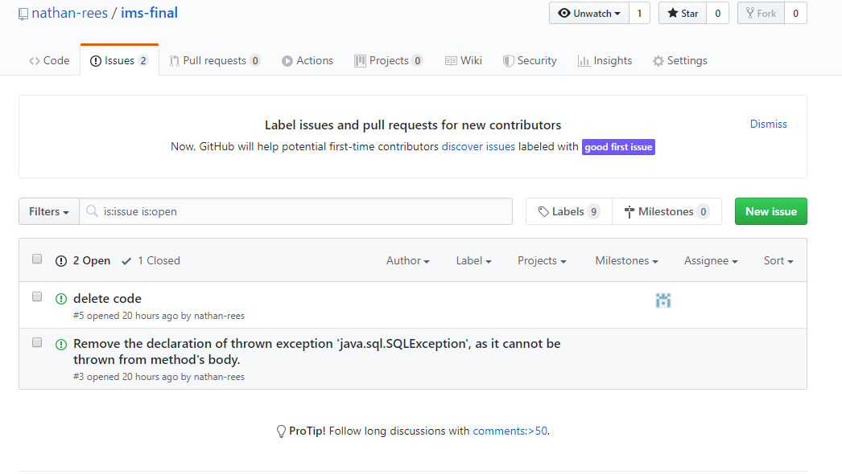
Adding issues

Slide 10
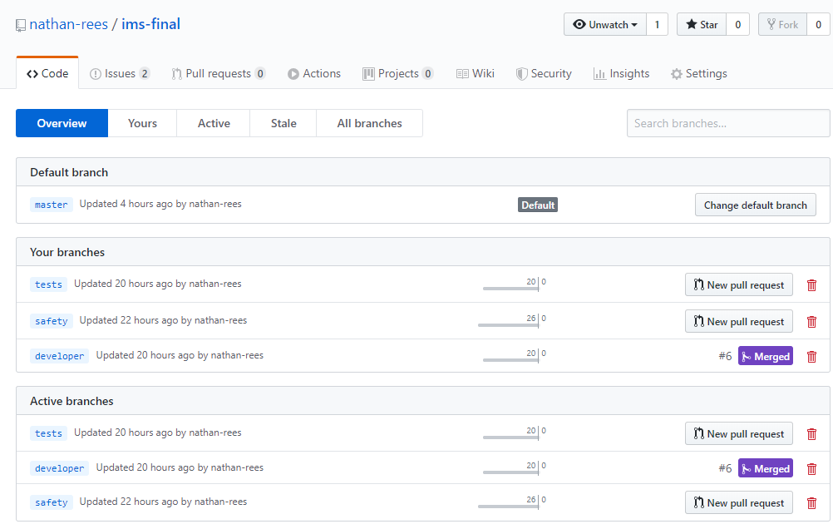
Using branches

